Slide 1




Investigation of Stress Concentrations in Parts Manufactured with Fused Deposition Modeling
Hope Elmer and Alexandre Lasalarie
Mentor: Dr. David Lanning
College of Engineering
Department of Aerospace Engineering
Arizona NASA Space Grant Statewide Symposium
Tempe, AZ

Slide 2

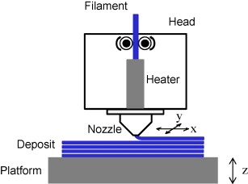
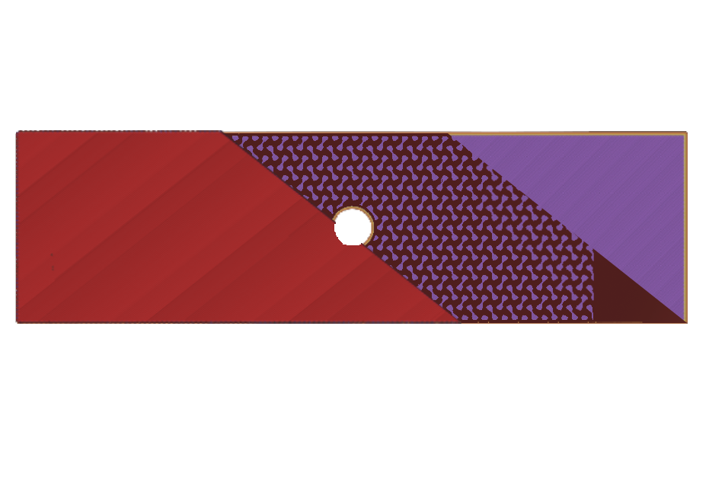
Fused Deposition Modeling (FDM),
a type of 3D printing, is highly customizable
Process:
Parameters:
Solid Top Layer
Perimeter
Solid Base Layer
Source: Ahn, D., Kweon, J., Kwon, S., "Representation of surface roughness in fused deposition modeling," Journal of Materials Processing Technology, Vol. 209, No. 15, 2009, pp. 5593-5600.
Gyroid Infill

Slide 3
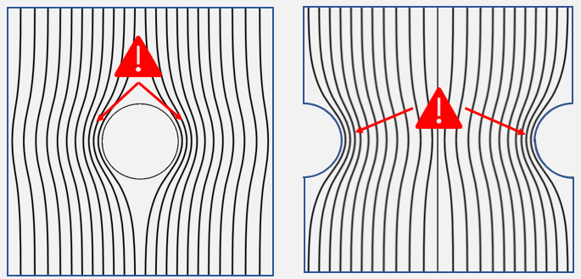
Effects of stress concentrations
in FDM parts has yet to be studied
Source: McGinty, B., “Stress Concentrations at Holes,” Stress concentrations at holes Available: https://www.fracturemechanics.org/hole.html.

Slide 4
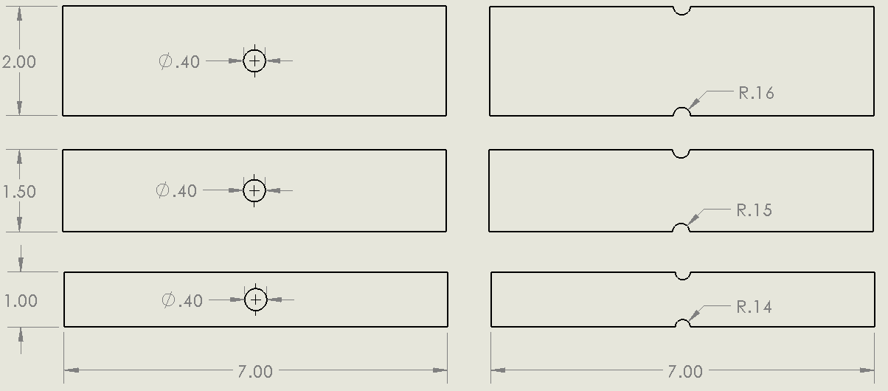
The studied specimens have equal
theoretical stress concentrations across the widths
Theoretical K
2.5
2.4
2.2

Slide 5
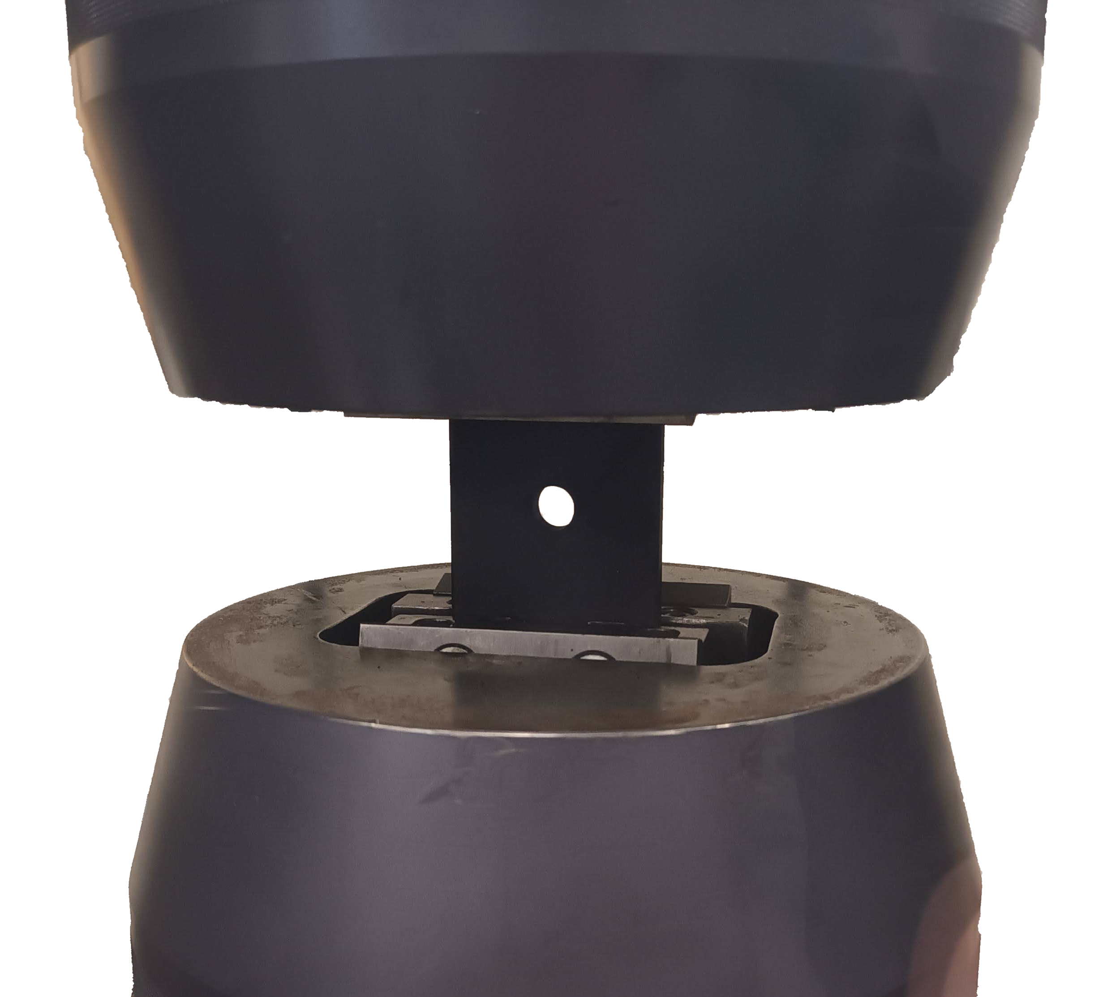
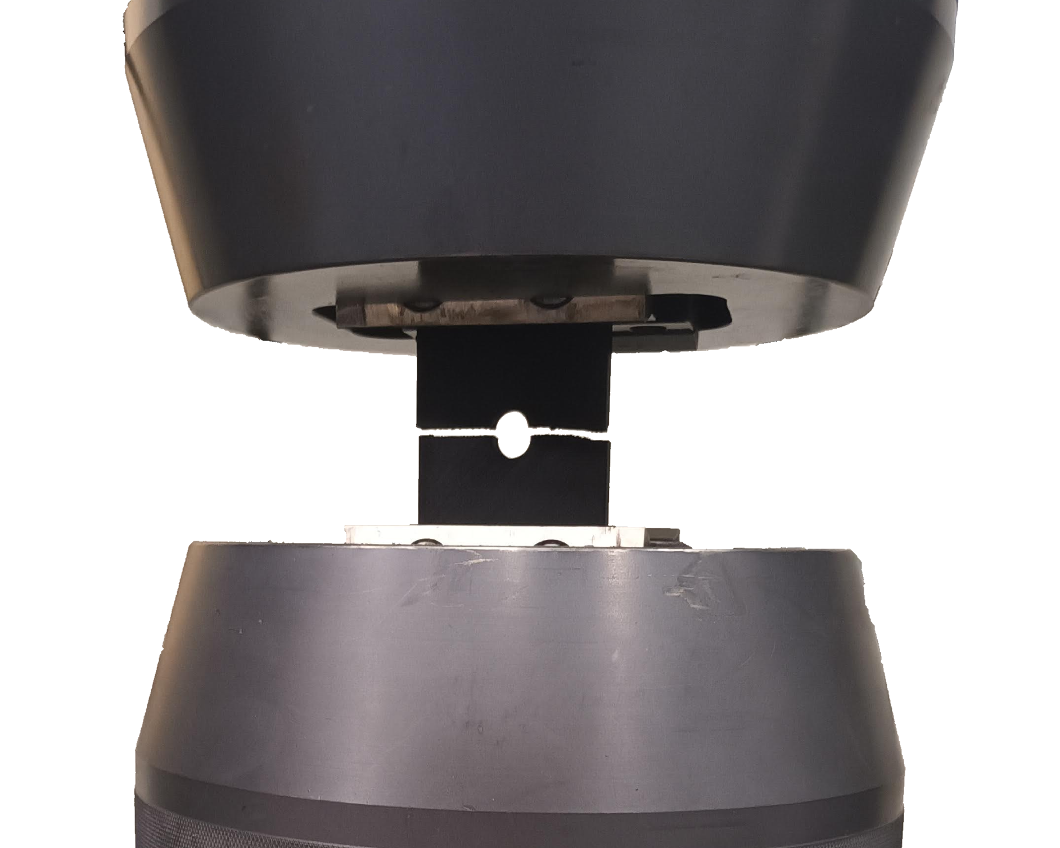
The specimens are tested in tension until failure

Slide 6
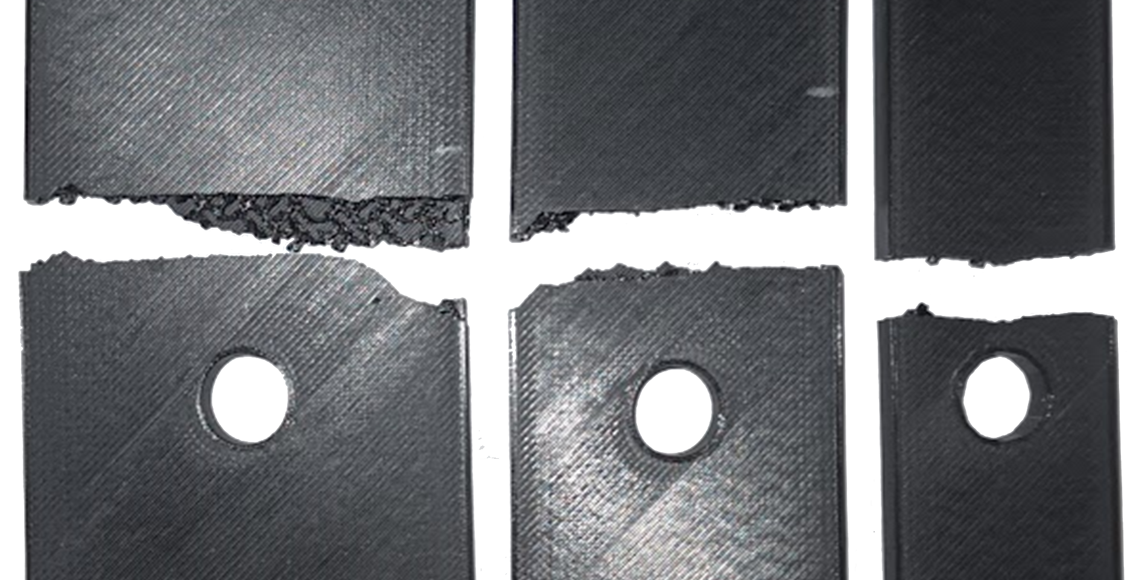
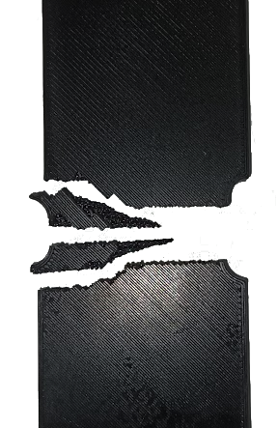
Failure location deviates from predicted location
20% Infill Density
60% Infill Density

Slide 7
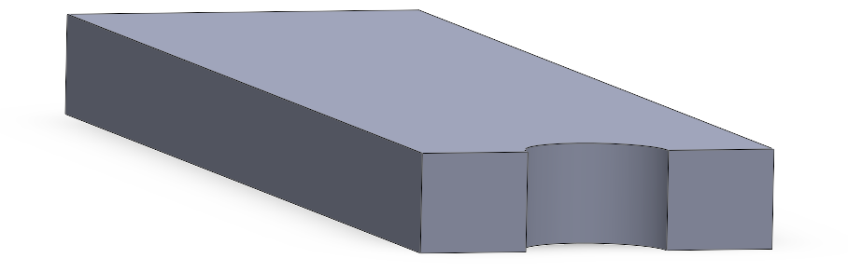
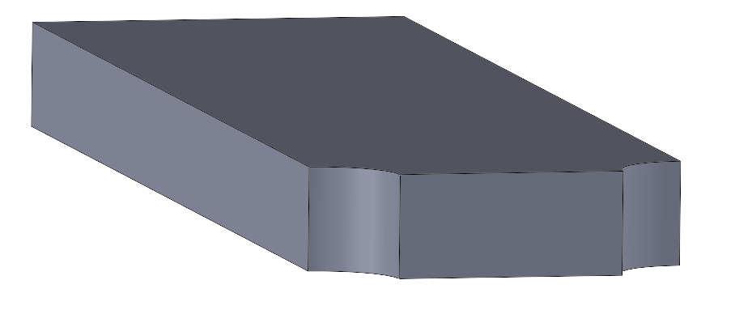
Experimental data contradicts theory

Slide 8
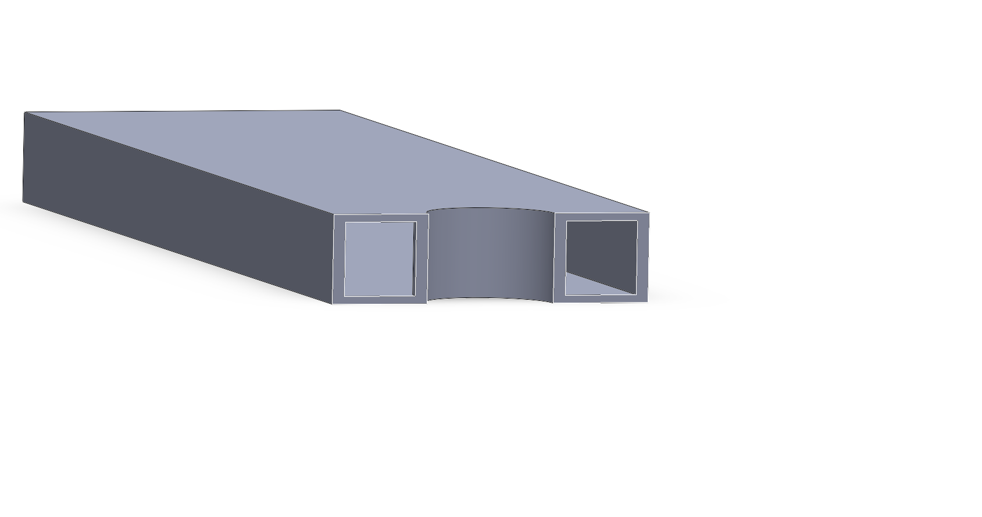
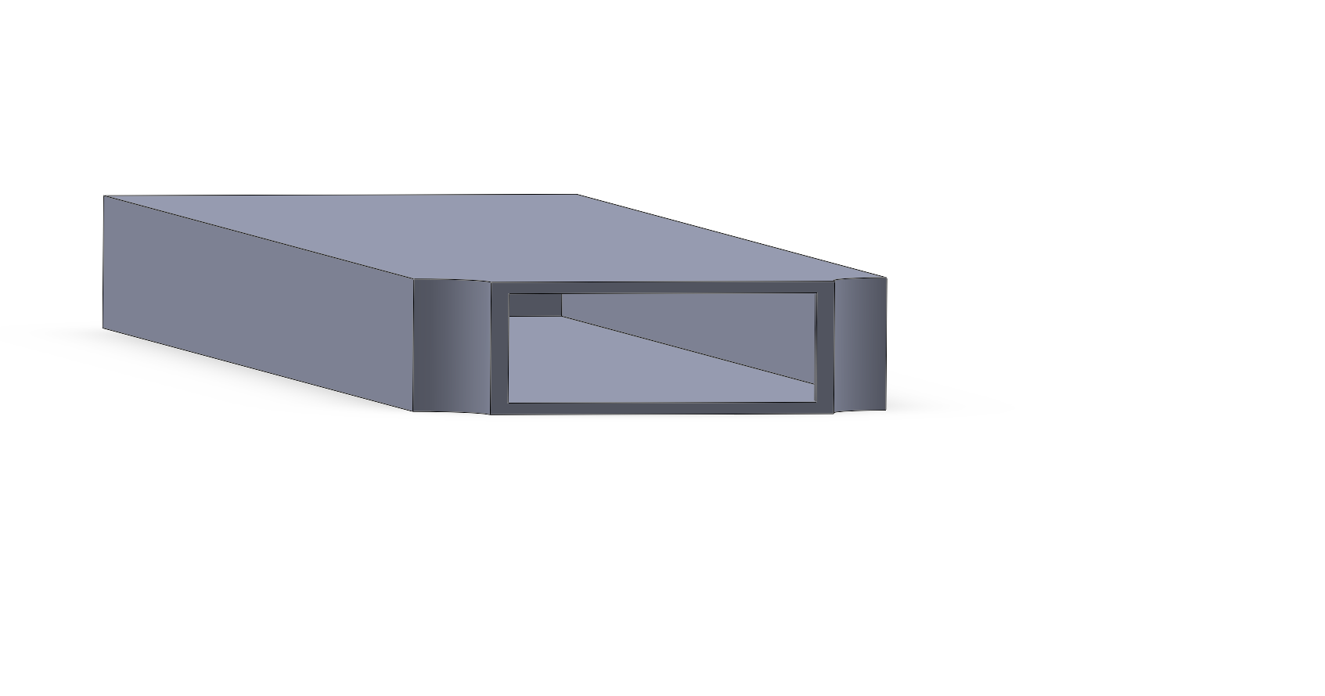
The difference between stresses is reduced
by taking the stress with respect to the ‘shell’
Hole
Notch
20%
40%
60%

Slide 9
The experimental K values for both
specimens are lower than the theoretical K value

